Slide 1
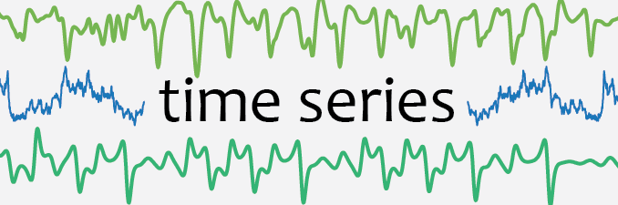

Slide 2


The Autoregressive Model
AR(1):
AR(p):

Slide 3


The Goal: A stationary process
First and second moments time invariant

Slide 4
Why Stationarity?
Understanding of time series not time dependent
Because we have models for stationary time series

Slide 5
Take an AR(1) Model

Slide 6
The 3 cases
A₁ < 1 ….. (A₁)^{inf} → 0
A₁ = 1 ….. (A₁)^{inf} → 1
A₁ > 1 ….. (A₁)^{inf} → inf

Slide 7
A₁ > 1
Explosive time series, we won’t worry about it.

Slide 8
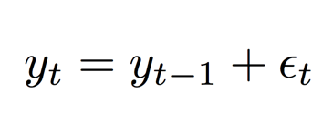
A₁ = 1
Unit Root
Simplest case is a random walk:
Unit roots can be made stationary by differencing.

Slide 9
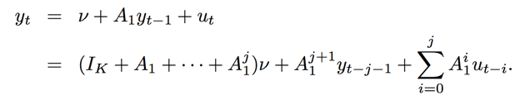
A₁ < 1
Stable AR Process
We consider this process as j → inf

Slide 10


As j → inf
Thus We Get:

Slide 11

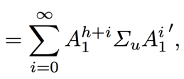

Two First Moments:

Slide 12
Stability Implies Stationarity
(Assuming infinite time)

Slide 13
What if A₁ is a matrix?

Slide 14
The Vector Autoregressive Model
K Variables
y_{t} is (K X 1)
A₁ is (K X K)
v is (K X 1)
u_{t} is (K X 1)

Slide 15
Lets create a rule….
Given our matrix A of y_{t} = Ay_{t-1} + u_{t}
If:
det(I_{k} - Az) != 0 for |z| <= 1 y_{t} is stable.
This means that all roots of det(I_{k} - Az) = 0 must be >1.
This matters because if above holds the eigenvalues of A are less than 1.
The equation that comes out of solving for det(1 - Az)=0 is called the reverse characteristic polynomial.
Notes:
All eigenvalues of the (m × m) matrix A have modulus less than 1 if and
only if det(Im − Az) à= 0 for |z| ≤ 1, that is, the polynomial det(Im − Az) has no roots in and on the complex unit circle.

Slide 16

What If we have a VAR(p) Model?

Slide 17
We can represent our VAR(p) as a VAR(1)

Slide 18
Another way to represent an VAR(p) process
y_{t} = A(L)*y_{t} + u_{t}
A(L) = A₁L+A₂L²+...+A_{p}L^{p}
L is a “backshift/lag operator” where A₁L*y_{t}= A₁y_{t-1}

Slide 19
Granger Causality
Given a Model of variables A,B,C,D,.... From time 0,...,t
A variable A at time t-1 “granger causes” variable B at time t if:
The model of <All variables from time t-1,...,0> -> B
is better than
The model of <All variables from time 0,....,t-1 \ variable A at time t-1> -> B
This test is straight-forward for a VAR model

Slide 20

Structural Vector AutoRegressive Models(SVAR)
Instead of uncorrelated error terms for a VAR they are correlated.
We can then solve for an uncorrelated error term.
(This is done using Choleski decomposition)

Slide 21
Terms To Define
Trends
Drifts
Seasonality
Periodicity
Cyclicity

Slide 22
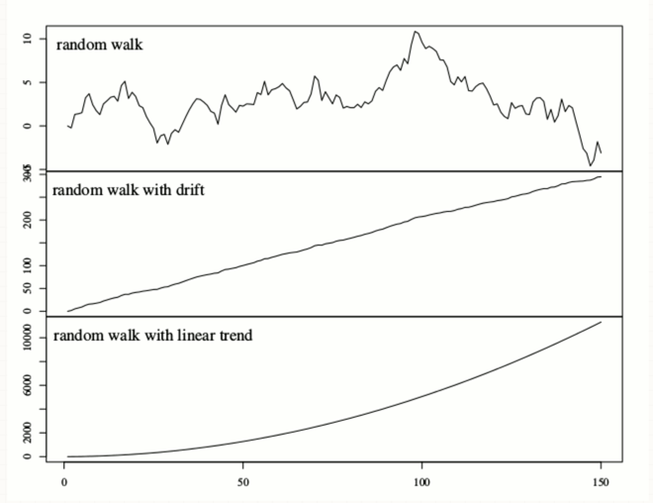
A₁=1
Drift
Trend
y_{t} = c + A₁y_{t-1} + u_{t}
y_{t} = d*t + A₁y_{t-1} + u_{t}

Slide 23
Seasonality, Cyclicity and Periodicity
Seasonality occurs when the time time series is affected by “seasonal factors”
Seasonal factors: quarter of the year or day of the week.
Always of a fixed and known period.
Periodicity refers to the period of seasonality
Cyclicity occurs when time series contain rises and falls not of a fixed period.
Generally are longer. Such as business cycles.
Length of current cycle is not known beforehand.

Slide 24
Dynamic Bayesian Networks

Slide 25
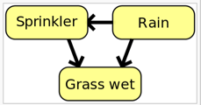
Bayesian Network
Represents conditional independencies
Pr(G,S,R)=Pr(G|S,R)Pr(S|R)Pr(R)

Slide 26
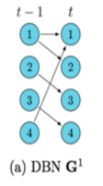
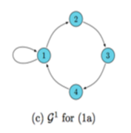
Dynamic Bayesian Network

